Slide 2
Improving k-buffer methods via Occupancy Maps
Andreas A. Vasilakis and Georgios Papaioannou
Dept. of Informatics, Athens University of Economics & Business, Greece

Slide 3
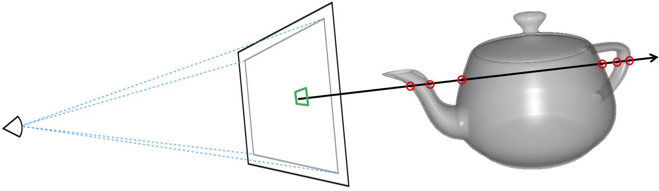
Multi-fragment Visibility Determination
[Problem]:
generation of more than one out-of-order fragments per pixel
[Goal]:
peel()
sort()
resolve()
[ray casting]

Slide 4
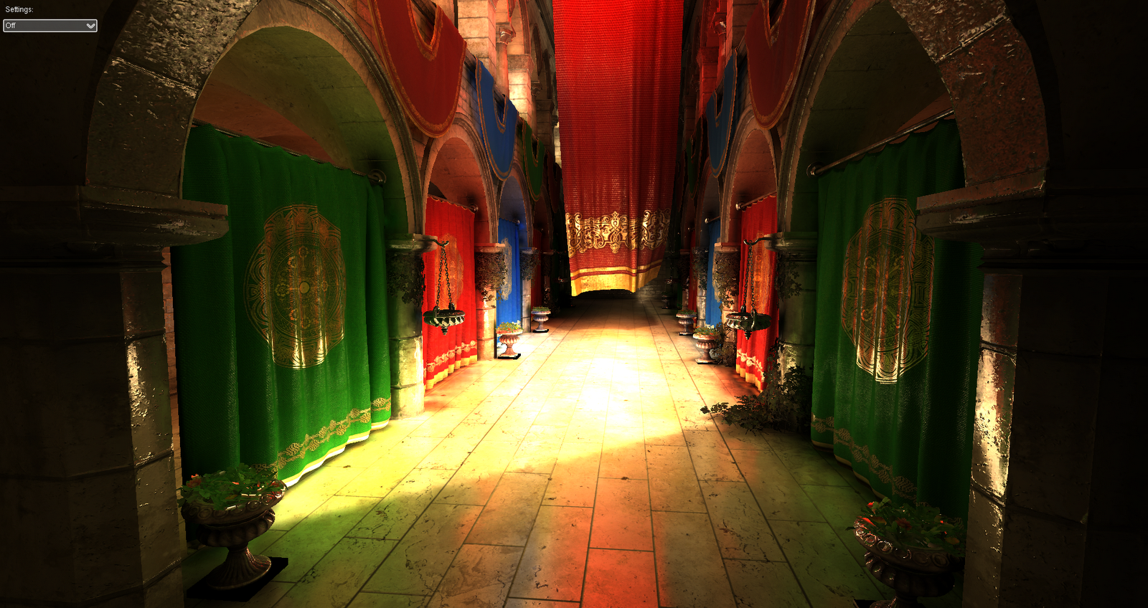
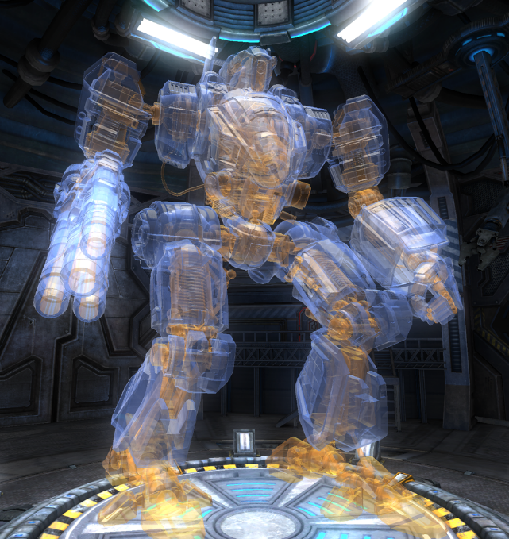
Screen-space Applications (1)
Photorealistic Rendering
[global illumination]
[transparency]

Slide 5

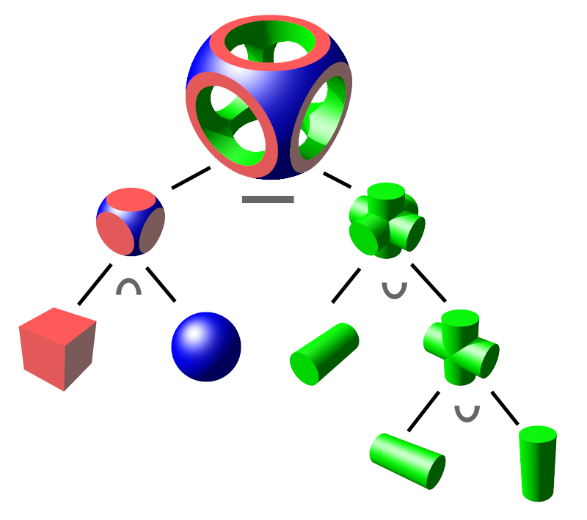
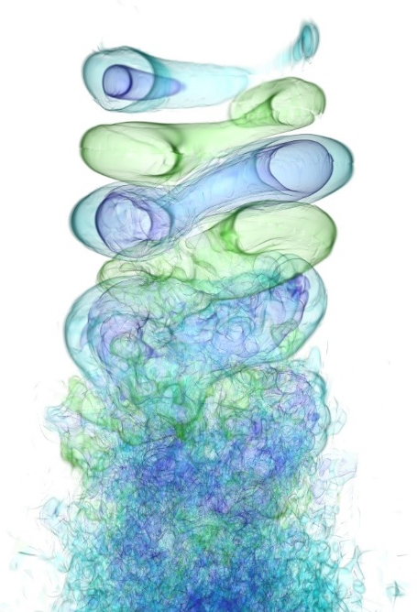
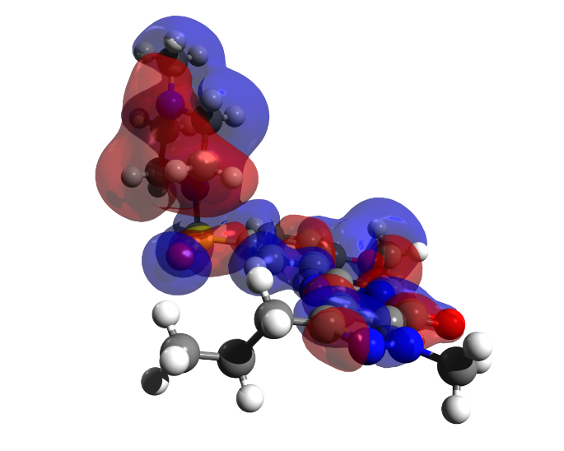
Screen-space Applications (2)
Visualization & Processing
[flow]
[molecular]
[hair]
[solid]

Slide 6
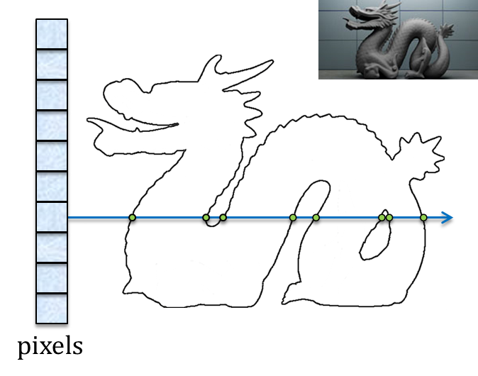
Multi-fragment Rendering Solutions (1)
A-buffer: Store [all] fragments then Sort them

Slide 7
Multi-fragment Rendering Solutions (2)
A-buffer: Store [all] fragments then Sort them
Limitations:
Memory
wasteful allocation
potential overflow
Performance (@sorting)
local memory cache overflow & latency issues

Slide 8
Multi-fragment Rendering Solutions (3)
k-buffer: Store & Sort [k-closest] fragments
k=4

Slide 9
Multi-fragment Rendering Solutions (4)
k-buffer: Store & Sort [k-closest] fragments
k=4
Limitations:
[Bavoil07,Bavoil08]
RMW hazards
geometry pre-sorting
upper-bounded k
[Liu10,Maule13]
extra geometry pass
depth precision conversion
[Salvi13]
extreme fragment congestion
modern hardware

Slide 10
Multi-fragment Rendering Solutions (5)
k-buffer: Store [all] fragments then Select & Sort [k-closest] ones
k=4

Slide 11
Multi-fragment Rendering Solutions (6)
k-buffer: Store [all] fragments then Select & Sort [k-closest] ones
k=4
Limitations:
[Salvi11,Yu12]
A-buffer construction

Slide 12
Multi-fragment Rendering Solutions (8)
k⁺-buffer [Vasilakis14,Vasilakis15]: Store [k-closest] fragments then Sort them
k=4
Fragment Culling Mechanism:
Concurrently discards an incoming fragment that is farther from all currently maintained fragments (using max element).

Slide 13
Multi-fragment Rendering Solutions (8)
k⁺-buffer [Vasilakis14,Vasilakis15]: Store [k-closest] fragments then Sort them
k=4
Fragment Culling Mechanism:
Concurrently discards an incoming fragment that is farther from all currently maintained fragments (using max element).
Limitations:
Depends on the fragment arrival order.
Requires k-buffer to be initially filled.
Fragment elimination is performed inside pixel shader (not hardware-accelerated).

Slide 14
Novel Fragment Culling (1)
Ideal k-buffer solution: Find [k-th fragment] then Cull [farthest] them
k=4
Fragment Culling Mechanism:
perform extra geometry pass to compute k-th fragment.
k-buffer construction with depth testing enabled.
free from all previous limitations !!!
1
2

Slide 15
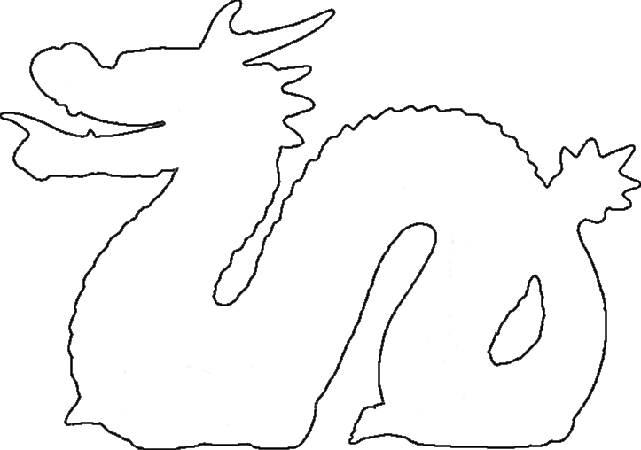


Novel Fragment Culling (2)
Approximate Solution: Exploit [fragment occupancy maps]
Fragment Culling Mechanism:
Perform early-z culling with the k_{a}-th fragment, nearest largest to the actual k-th (k_{a} ≥ k).
Bounding Box
Convex Hull
0
1
0
0
0
1
1
0
0
0
1
0
1
0
0
0
1
0
1
Occupancy bitmap

Slide 16
Novel Fragment Culling (3)
Approximate Solution: Exploit [fragment occupancy maps]
Fragment Culling Mechanism:
Perform early-z culling with the k_{a}-th fragment, nearest largest to the actual k-th (k_{a} ≥ k).
Algorithm:
Depth range is divided into B uniform consecutive subintervals.
Bounding Box
Convex Hull
1
1
2
3
4

Slide 17
Novel Fragment Culling (4)
Approximate Solution: Exploit [fragment occupancy maps]
Fragment Culling Mechanism:
Perform early-z culling with the k_{a}-th fragment, nearest largest to the actual k-th (k_{a} ≥ k).
Algorithm:
Depth range is divided into B uniform consecutive subintervals.
Occupancy bitmap indicates fragment presence in each bucket.
1
2
0
1
0
0
0
1
1
0
0
0
1
0
1
0
0
0
1
0
1
1
2
3
4
Occupancy bitmap

Slide 18
Novel Fragment Culling (5)
Approximate Solution: Exploit [fragment occupancy maps]
Fragment Culling Mechanism:
Perform early-z culling with the k_{a}-th fragment, nearest largest to the actual k-th (k_{a} ≥ k).
Algorithm:
Depth range is divided into B uniform consecutive subintervals.
Occupancy bitmap indicates fragment presence in each bucket.
Accumulation of 1s until you reach k value → 𝑂(𝑘) time.
1
2
3
0
1
0
0
0
1
1
0
0
0
1
0
1
0
0
0
1
0
1
1
2
3
4
Occupancy bitmap

Slide 19
Novel Fragment Culling (6)
Approximate Solution: Exploit [fragment occupancy maps]
Fragment Culling Mechanism:
Perform early-z culling with the k_{a}-th fragment, nearest largest to the actual k-th (k_{a} ≥ k).
Algorithm:
Depth range is divided into B uniform consecutive subintervals.
Occupancy bitmap indicates fragment presence in each bucket.
Accumulation of 1s until you reach k value → 𝑂(𝑘) time.
Discard fragments with depth value > k_{a}-th fragment.
1
2
3
4
0
1
0
0
0
1
1
0
0
0
1
0
1
0
0
0
1
0
1
1
2
3
4
Occupancy bitmap

Slide 20
Results using our culling mechanism at
k-buffer: Store & Sort [k-closest] fragments
k=4
[Bavoil08]
(alleviate RMW hazards)
Quality (↑)
[Liu10,Maule13,Salvi13]
(reduced fragment racing)
Performance (↑)

Slide 21
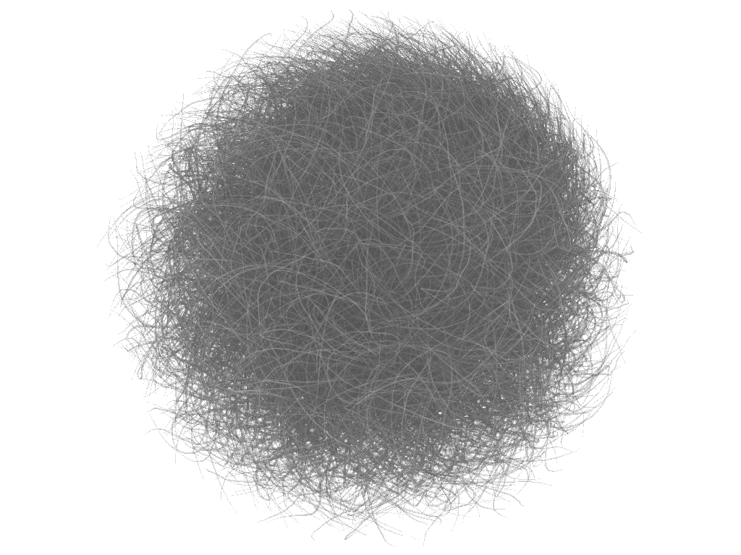

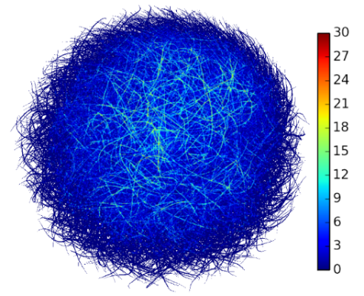
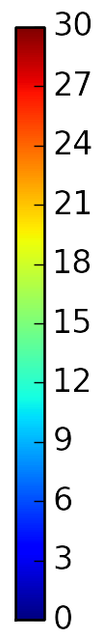

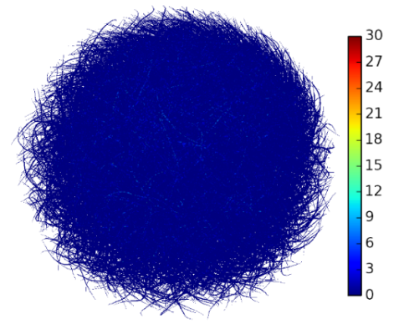
Results
Quality Comparison:
[Vasilakis14]
[Bavoil08]
29.5%
0.6%
error

Slide 22
Results using our culling mechanism at
k-buffer: Store [all] fragments then Select & Sort [k-closest] ones
k=4
[Salvi11,Yu12]
(reduction of stored fragments)
Memory (↓)
Performance (↑)

Slide 23
Results using our culling mechanism at
k⁺-buffer: Store [k-closest] fragments then Sort them
k=4
[Vasilakis14, Vasilakis15]
(reduced fragment racing)
Performance (↑)

Slide 24
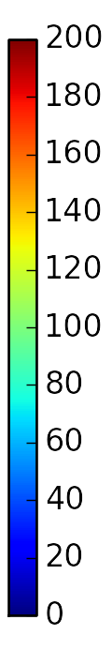
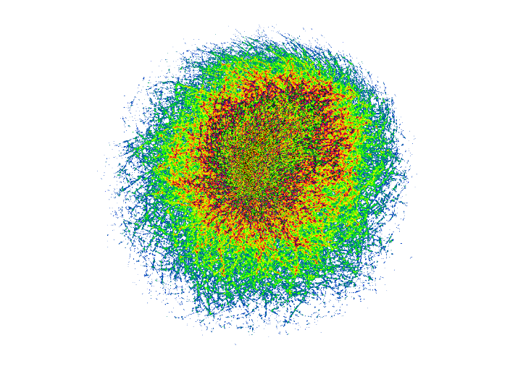
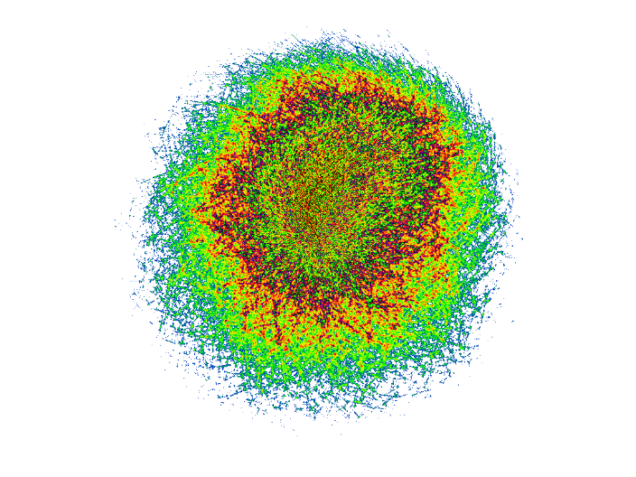
Results
Fragment Culling Comparison:
[Vasilakis14]
our culling
k = 8
63.66%
98.28%
layers

Slide 25
Results
Performance Comparison: Impact of k

Slide 26
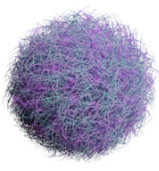
Results
Performance Comparison: Impact of buckets (= 32∙d)
k = 8

Slide 27
Conclusions
Efficient fragment culling:
Exploits fragment occupancy maps to approximate the k-th fragment.

Slide 28
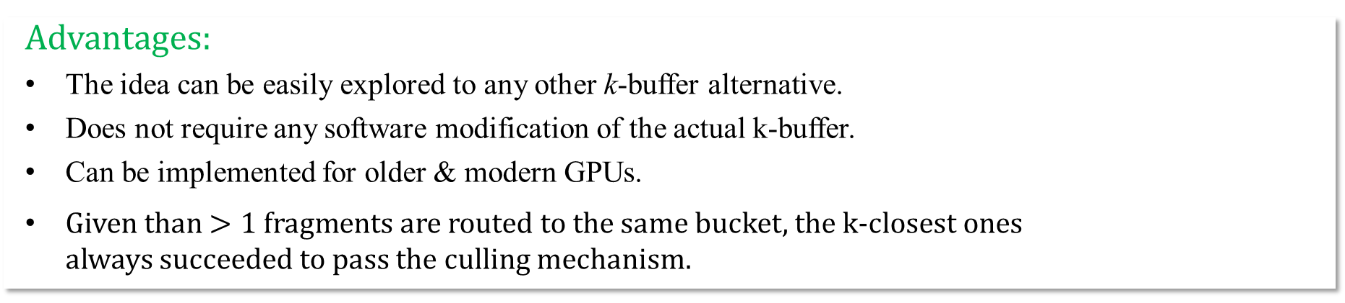
Conclusions
Efficient fragment culling:
Exploits fragment occupancy maps to approximate the k-th fragment.
Advantages:
The idea can be easily explored to any other k-buffer alternative.
Does not require any software modification of the actual k-buffer.
Can be implemented for older & modern GPUs.
Given than $>1 \text{fragments}$are routed to the same bucket, the k-closest ones always succeeded to pass the culling mechanism.

Slide 29
Conclusions
Efficient fragment culling:
Exploits fragment occupancy maps to approximate the k-th fragment.
Advantages:
The idea can be easily explored to any other k-buffer alternative.
Does not require any software modification of the actual k-buffer.
Can be implemented for older & modern GPUs.
Given than $>1 \text{fragments}$are routed to the same bucket, the k-closest ones always succeeded to pass the culling mechanism.
Limitations:
Works well only when the generated per-pixel fragments 𝑛 ≫ 𝑘.
Fragment rejection process (speed up) is highly dependent on the occupancy map resolution.

Slide 30


The end
Shader Code Available:
http://glide.aueb.gr/
Acknowledgements:
This research has been co-financed by the European Union (European Social Fund - ESF) and Greek national funds through the Operational Program "Education and Lifelong Learning" of the National Strategic Reference Framework (NSRF) - Research Funding Program: ARISTEIA II-GLIDE (grant no.3712).

Slide 31
References
[Bavoil2007] Multi-fragment effects on the GPU using the k-buffer (I3D)
[Bavoil2008] Deferred rendering using a stencil routed k-buffer (ShaderX6)
[Liu2010] FreePipe: a programmable parallel rendering architecture for efficient multi-fragment effects (I3D)
[Salvi2011] Adaptive transparency (I3D)
[Yu2012] A framework for rendering complex scattering effects on hair (I3D)
[Maule2013] Hybrid transparency (I3D)
[Salvi2013] Pixel synchronization: Solving old graphics problems with new data structures (SIGGRAPH)
[Vasilakis2014] k+-buffer: Fragment synchronized k-buffer (I3D)
[Vasilakis2015] k+-buffer: An efficient, memory-friendly and dynamic k-buffer framework (TVCG)

